Slide 1
Extreme Data Storage – Dealing with Content explosion
Srikanth Venkataseshu and Pete Brey
HP StorageWorks, Scalable NAS Division

Slide 2



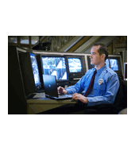


New Business Models Require New Infrastructure Models
Photo Sharing & Finishing Services
Streaming Video Services
Security & Surveillance
Enabled by
Globalization of technology’s reach
Faster, better, cheaper technology
Music and Ringtone Services
Online Social Communities / Content Sharing
Digital Animation

Slide 3
Web Scale Storage - Challenges
Volatile and Unpredictable growth.
Testing “Efficiency” limits.
Exceptional management issues.
Uptime and SLA predicaments.
Affordability constraints.
Server and Storage Sprawl.

Slide 4
Static Media Hosting/Serving
Static Media Content
Challenges
User pictures/text files/blogs
Ringtones/wallpapers/rich media portals.
Workload characterized by unusual data access patterns.
File size range from small thumbnail images to High resolution images (photo sharing).
Explosive Growth in online subscribers.
Load is unpredictable.
Scaling is difficult.
Large investment ahead of demand.
“Long tail” content
Throughput stress on the system.

Slide 5
Internet Content Streaming
Enables
Challenges
Delivery of Video/Audio media files over the internet.
Live or Pre-recorded on-demand streaming.
Progressive download or True Streaming options.
Bandwidth conserving multi-bit rate delivery.
Sequential data access of media content.
High volume of concurrent jitter-free stream delivery.
Linearly scalable storage to accommodate high volume of UGC Videos and/or Premium content.
Fault tolerant systems to stream content 24X7
Serve thousands of SD/HD content.
Maintain high QoS.
Scalable performance without content duplication.
Online archive of “Long tail” Content.

Slide 6
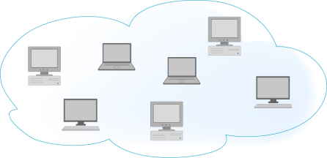
Monolithic and conventional Architecture
Scalability Limits
Unbalanced Load
Increased data footprint
Poor utilization
Multiple name space
Large number of NFS/CIFS Mounts
Complex management
High cost solution.
Web Front End or other media access portal (Server Farm)
App Server
App Server
App Server
App Server
App Server
Load Balancer
1
2
3
20
NAS System
NAS System
NAS System
NAS System
DAS
DAS
DAS
DAS
Constant ‘hot” data replication

Slide 7
Capacity Optimized Web Scale Solution
Massive Scalability up to multiple Petabytes and even Exabytes.
Predictable performance.
Smallest storage footprint.
Easily manageable units of storage.
Reduced time to market.
Predictable SLA.
Resilient systems
“Integrated” Solution for Flexible deployment.

Slide 8
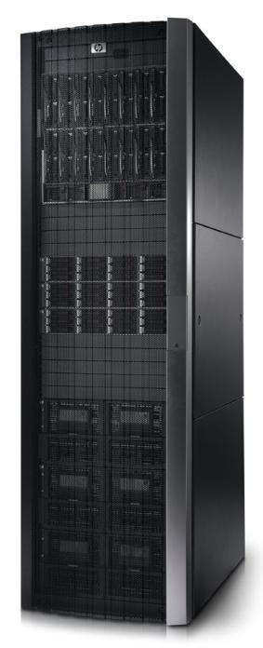
HP 9100 Extreme Data Storage System
Solves the challenges, enables the opportunities
Extreme scalability
  Ability to scale performance and capacity independently
  Non-disruptively add servers and storage online with a single command
  Extreme density of storage decreases the data center footprint
Unified management
  System configuration and control from single management interface
  Reduction in time and staff required to deploy and maintain system as a whole
  Elimination of application tier
Extreme affordability
  Archived materials can now be moved to more affordable content on demand system
  Lower acquisition cost
  Lower management costs – manage PB/admin not TB

Slide 9
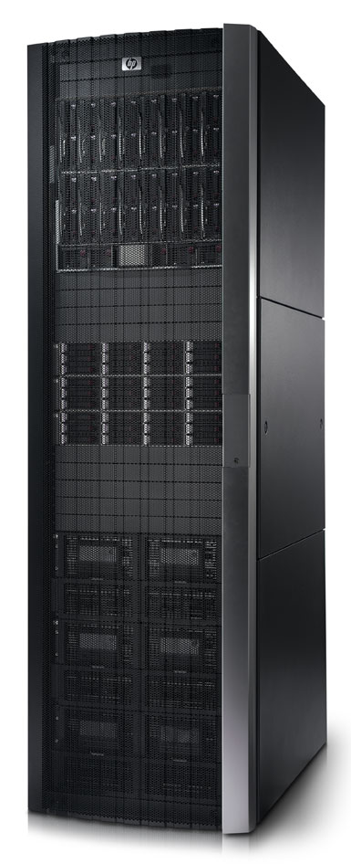
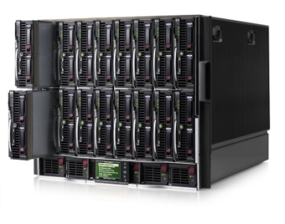
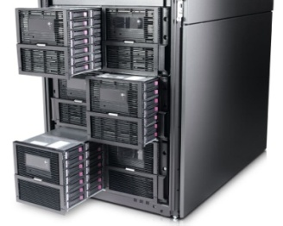
HP 9100 Extreme Data Storage System
Integrated hardware/software solution
Performance Blocks
HP’s Industry Leading BladeSystem
  Up to 12.8 cores/U
  Starting at 4 blocks, expand up to 16 blocks
  Flexible industry standard platform
Capacity Blocks
Industry Leading Density
  Up to 12TB/U
  Starting at 246TB, expand to over 820TB
  Scales in 82TB Capacity Blocks
Software
Proven in Content Rich Environments
  Integrated system management
  Multiple access protocols
    NFS, HTTP, Application co-hosting
    Applications can run directly on blades

Slide 10

Living Proof
Over 6 Petabytes today
Growing to 20 Petabytes in 2010
Hundreds of HP Scalable NAS nodes
Three separate data centers
Managed by a very small team
(Petabytes per admin, not terabytes)
Built on HP
  HP StorageWorks
  HP Scalable NAS
  HP BladeSystem
Notes:
Presentation Title
10

Slide 11
HP 9100 Extreme Data Storage
Enabling new business models for web 2.0 customers
  Extreme Scalability
  Unified Manageability
  Extreme Affordability
Visit
www.hp.com/go/ExtremeStorage

